Slide 1
English Stylistics
Week 2
Stylistics and stylistic features

Slide 2
Today’s lecture
Why there are different styles?
How to perceive and analyze the style?
→ Stylistic features

Slide 3

Text 1

Slide 4
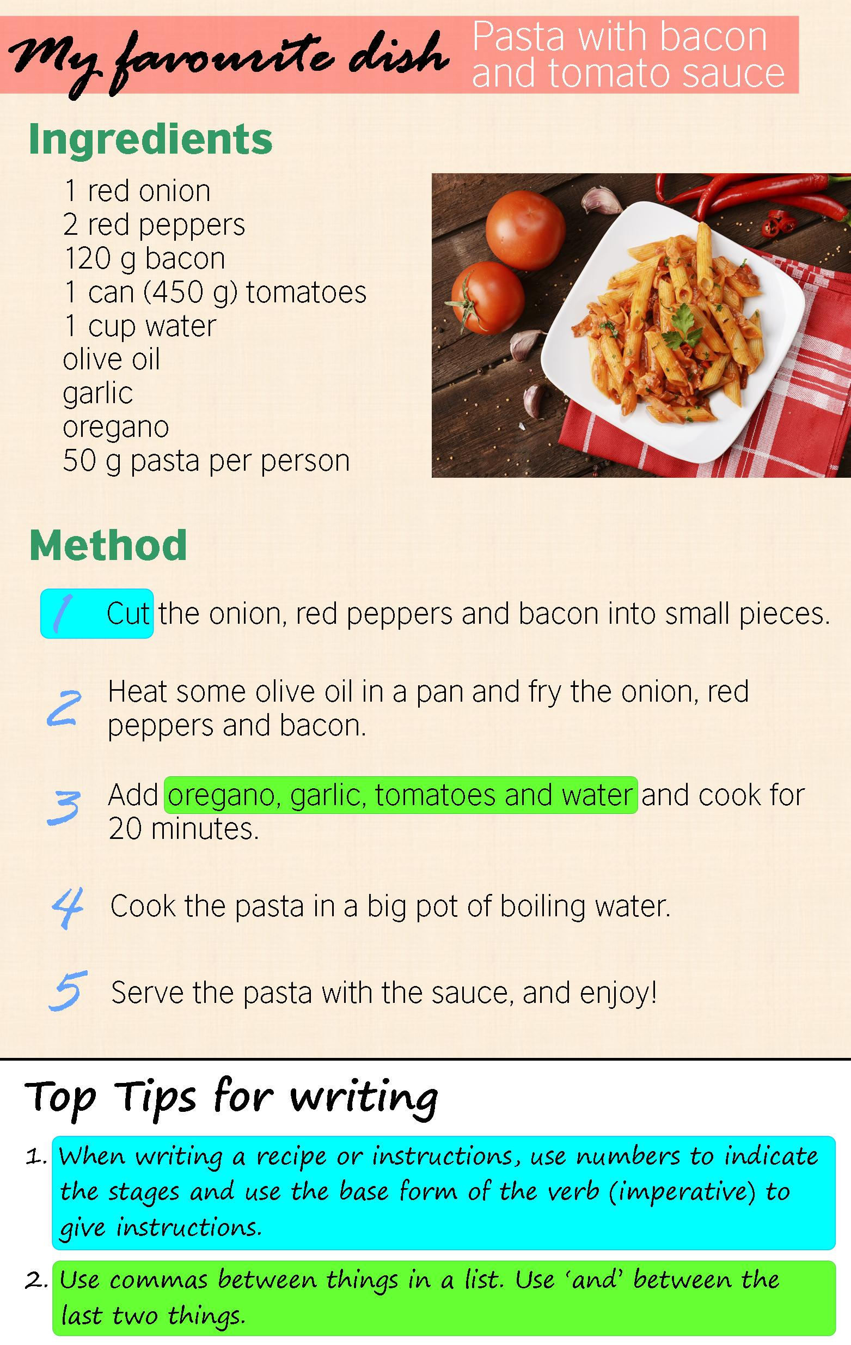
Text 2

Slide 5
Text 3
Hiroshima – A city (pop. 542 000) of Honshu, Japan. It was largely destroyed by an American atomic bomb (6 Aug. 1945), the first used in warfare. After reconstruction the city became an active port, with paper and canning industries.
Notes:
Hiroshima and Nagasaki

Slide 6
Text 4: Hiroshima by Naomi Replansky
My spoon was lifted when the bomb came down
That left no face, no hand, no spoon to hold.
Two hundred thousand died in my home town
This came to pass before my soup was cold.

Slide 7
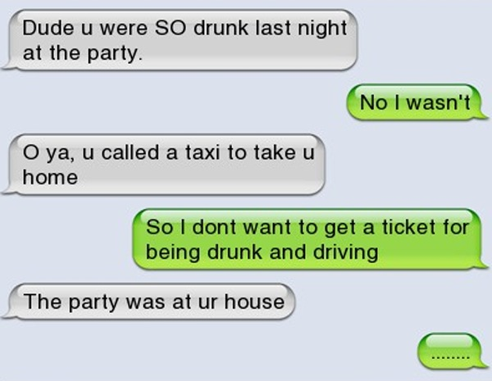
Text 5

Slide 8
Why different styles?
Style as saying different things in different contexts (content)
Style as saying the same thing in different ways. (form)
Style as speakers from different background (users)
Style as functions of texts (function)

Slide 9
Understanding “styles”
CONTENT
FORM
FUNCTION
USER

Slide 10
Why stylistics?
To understand the texts
To understand the language
To understand communication

Slide 11

How to perceive and analyze “style”?
The reading experiences + linguistics
Impression → description → interpretation
An analytical toolkit

Slide 12
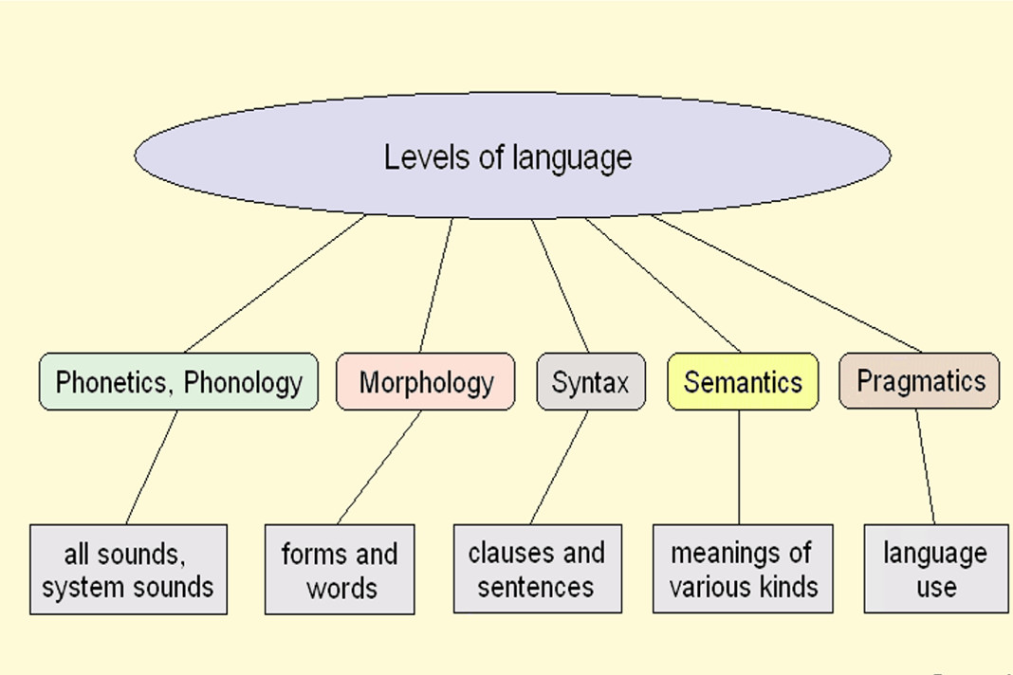

Slide 13
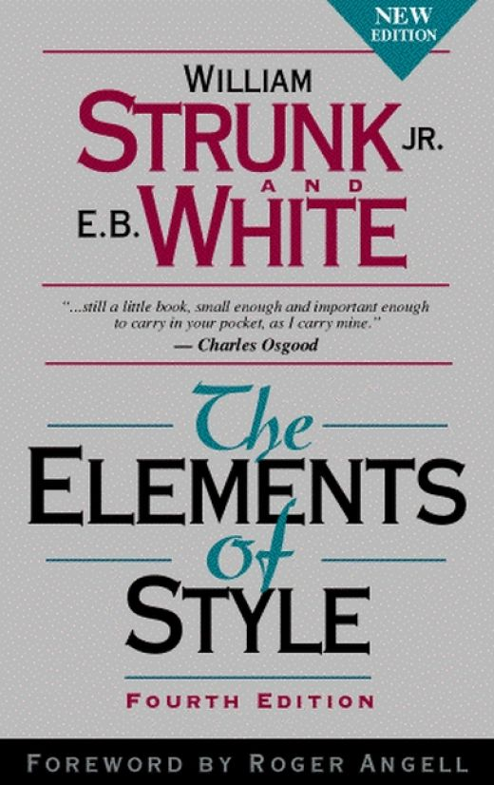
Capturing “style”
“We recognize a style only when certain choices of language features recur or prevail in a text” (Qian, p.19)
Stylistic features /style markers

Slide 14
Stylistic features
Sounds and sound patterns (phonological features)
Word-formation patterns (lexical features)
Choice of words and expressions (semantic features)
Sentence types and structures (syntactic features)
Discourse, meaning relation, etc.

Slide 15
Reading and discussion
What do you think of the two texts (Impression)
What kind of formal features recur or prevail in the texts? (Description)
What is the effect of these features? (Interpretation)

Slide 16
Text 4: before the gong rings
Lexical – “I”, “but”, modal verb (can), action verbs (sprint, scramble, grab, reach)
Syntactic – short, active sentences, sometimes broken or incomplete
Semantic – actions, planning, weighing of different sides
Discourse: colloquial expression, monologue
Effects?

Slide 17


Slide 18
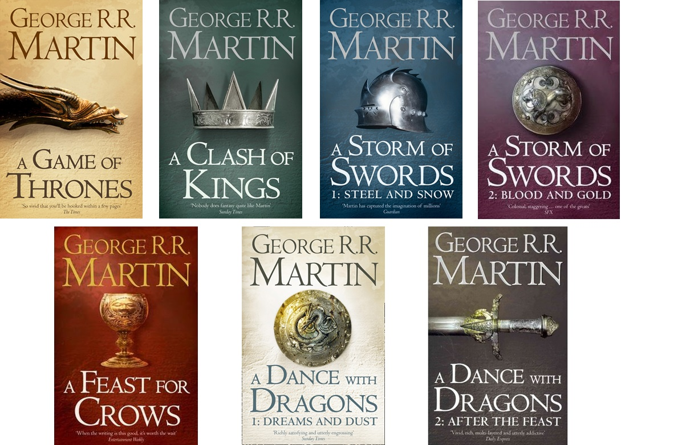

The Vow of the Night's Watch.mp4

Slide 19
Text 5 The vow of the night’s watch
Phonological – one or two syllables/word, alliteration (wear-win, watcher on the walls)
Lexical – short, simple and powerful words; concrete words, Anglo-Saxon words; “shall”

Slide 20
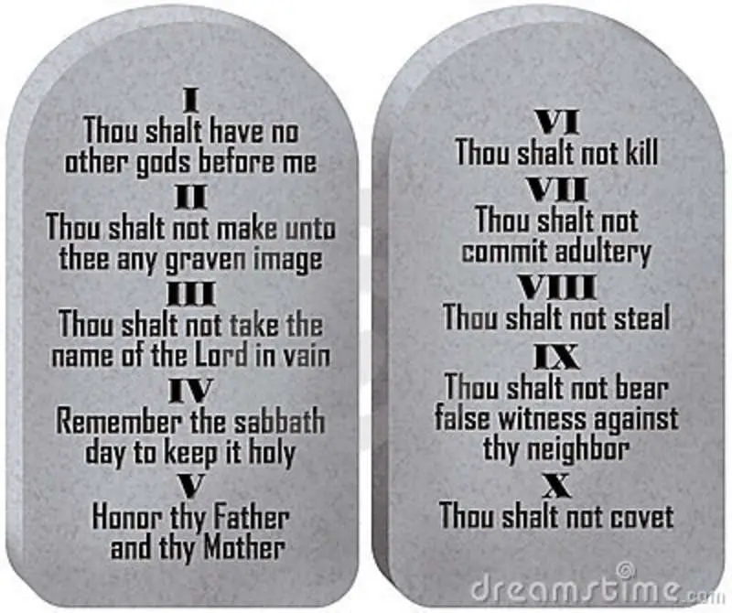

The use of “Shall”
Volunteering & promising
Obligation (legal)
Inevitability

Slide 21
Other features
Syntactic – short, assertive sentences of identical structures
Figures of speech – metaphor , parallelism
Discourse – prepared speech for reading in chorus, highly ritualized

Slide 22
永夜终至，吾辈铭记，巍巍大任，死亦无终。
无享妻爱，不履寸土，决绝子嗣，身归兄弟。
何言无冕，兄弟所望，何争俗荣，袍泽同心，
尽忠职守，生死于斯，心念所归，无惧无退。
铸兵利剑，暗夜无当；凝聚础石，长城屹立；
腾焰熊熊，炽烈华光；耀耀破晓，璨以晨光；
鸣无尽之号角，警外患之袭扰；锻坚钢之神盾，固王国之永宁。
于今挺身，奉以生命，以夜为始，死亦无终。

Slide 23
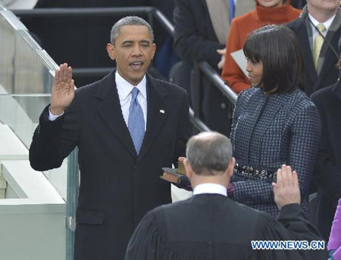

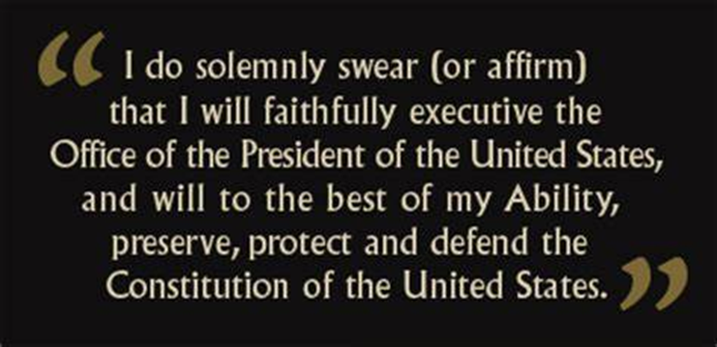
Vows

Slide 24
Summary: key issues in stylistics
Why Style – content, form, users & purposes
Why stylistics – Texts, languages and communication
How: Stylistic features (Description + Interpretation)

Slide 25
In case you missed the last lecture …
《实用英语文体学》钱媛，外语教学与研究出版社，2006
Class performance 10%
Assignments 20%
Quiz 30%
Final paper 40%

Slide 26
Next week: Lexical features
ROLL CALL
→ different types of words
→ creation of new words
→ English words of different origins
→ register（语域）and word choices

